Slide 1
Digital Organization Skills & Platforms
Wake Tech ILC
Presented by Ashley Tabron and Dawn Preston

Slide 2
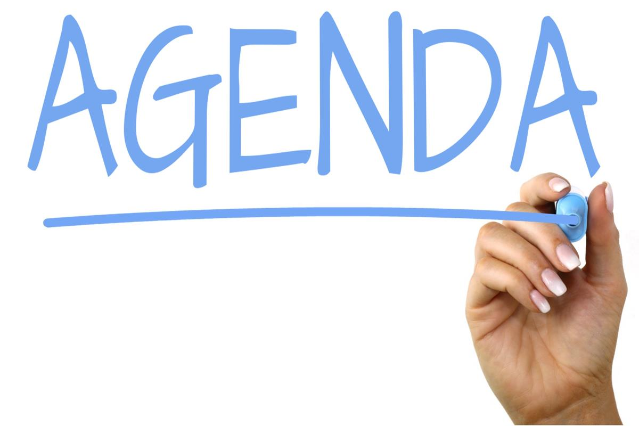
Today’s Agenda
Agenda:
Why digital organization?
File Naming
File Organization
Digital Calendars and Notes
To-Do Lists and MORE!
In the chat: Why did you come to this session today? What skills do you hope to leave with?
This Photo by Unknown Author is licensed under CC BY-SA
Notes:
Welcome to today’s session on Digital Organization Skills. You took the first step to digital organization by showing up! Congrats. Our hope is that after today’s session, you will walk away with some strategies that will help you stay on top of work, school, and home by using the tools that are already at your disposal. We’ll cover file naming and organization, digital calendars and notes apps, and finally some to-do lists that you can use to make sure you tackle all the items on your list. But first, tell me in the chat in a few words why you came to this session today.
Note to Speaker: (Read a few of the responses aloud/hopefully there will be some commonalties between the items and the topics we plan to cover in the session.
SAY: Some of the slides in the presentation have some useful videos that we can check out today, but you will also have access to these videos for the future.

Slide 3
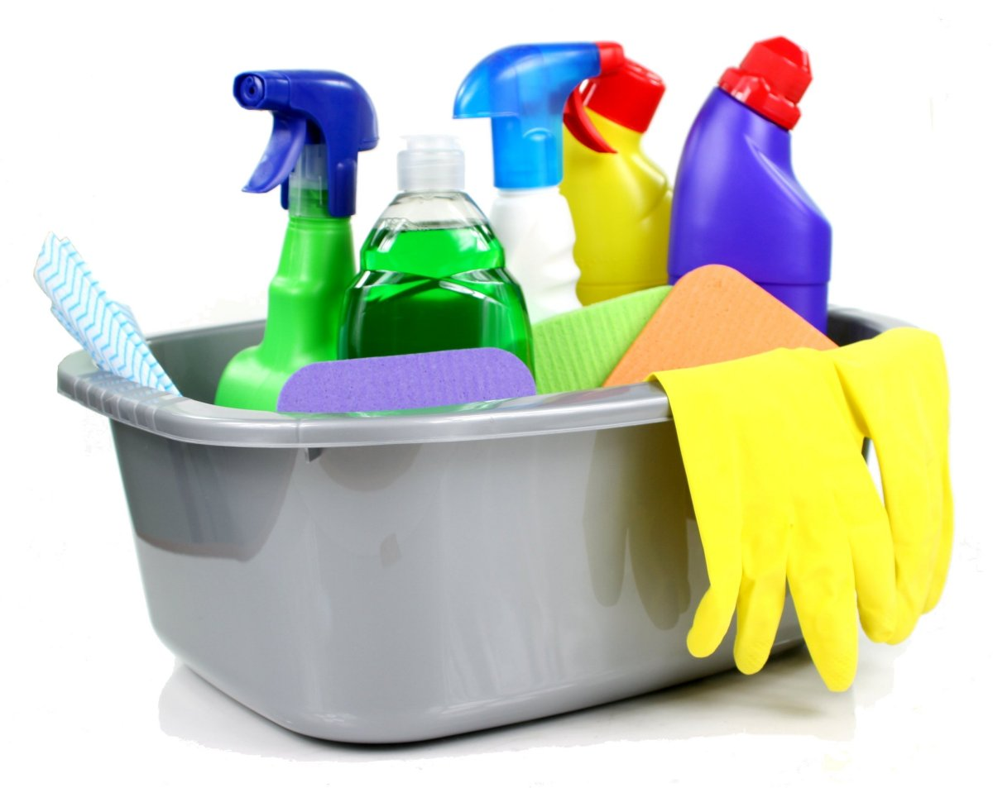
Why Digital Organization?
Why?
Time to tidy up!
It takes time!
Goals?
Easy to file
Easy to find
Reusable
This Photo by Unknown Author is licensed under CC BY-SA
Notes:
Now more than ever, we are spending increasing amounts of time in our digital spaces. Just like our physical ones, from time to time we need to make sure that our digital spaces are organized and easy to navigate. Fortunately, there are plenty of ways we can curate our digital spaces. First, it takes time to organize our digital lives, and it is a never-ending process that requires regular maintenance. Just as you wouldn’t clean your basement out in one day, apply the same ideals to your digital space. Hopefully by the end of this session you will have a system in place that makes it easy for you to file your documents in an easy to find place with a reusable system that works for you.

Slide 4

File Naming
Uncomplicated
Date
YYMMDD
Short Descriptive Phrase or Project Name
Version Number
Name them as SOON as you create them
This Photo by Unknown Author is licensed under CC BY-NC-ND
Notes:
The key to a good file naming system is KISS (keep it simple, silly). Consider future you that will need to find this information. Some tips for making sure your files are easy to find include a specifically descriptive phrase and adding the date. Another important tip is to include the version number so you can easily track the changes you made for your assignment. Finally name your documents AS soon as you create them. This will help to make sure you don’t miss the most important step that will make it easier for you to find your documents later.

Slide 5

Let’s Practice: What’s in a Name?
If you had a rhetorical analysis essay on “A Letter from Birmingham Jail” due on October 15th, what would you name it based on the previous slide?
What are some filing techniques you already use? Any tips or tricks to share with everyone?
This Photo by Unknown Author is licensed under CC BY-NC
Notes:
Now, let’s practice some of the conventions we learned. If you have an upcoming rough draft of a Rhetorical Analysis Essay on “A Letter from Birmingham Jail” due on October 15th, what would you name it based on the previous slide?
Note to speaker: Go through a few answers. Be sure to ensure students that no one is wrong, and they have to find the system that works well for them. Before we move on to folders, ask students if they have any naming tips and trips that work well for them.

Slide 6

My folders have Folders
Think minimal
Name strategically
Distinguish Between Working on and Archive folder
Create a root folder
While you’re here, make sure you back up files!
Don’t go folder crazy!
Check out the ABC folder method for inspiration!
This Photo by Unknown Author is licensed under CC BY-SA
Notes:
Next up, we will cover how to name your folders. This is a task that some skip, but it is a crucial component to a good digital organization system. Naming folders can be daunting, but if done correctly, folders are the most critical step in digital organization. When naming a folder, think minimally. Make sure you have a folder for each class. Similar to how you name a file, folders also need to be named strategically for easier access at a later time. If you have files that you want to keep from a class that is no longer current, use an archive folder to help you declutter your space. Also consider creating a root folder which houses all of the files for a particular class that you can easily find at a moment’s notice. Since we’re in the folders, make sure you back up all of your files. Finally, don’t get too folder crazy. If you find that your folders only contain one or two items, you probably need to rethink your folder system.
Note to speaker: this video shows a method for note taking, but you don’t have to show it (a little lengthy). Just tell students they have access to it for later.

Slide 7
What tips and tricks Have you learned so Far?
Answer in the chat!
Notes:
Have students list a few of the tips that they have learned about naming files and folders. When finished say, next let’s talk about some of the applications that can help us stay on track with our digital tasks and assignments.

Slide 8
Calendars
What system do you currently have for keeping up with important deadlines and due dates? Does it work well for you? Answer in the chat!

Slide 9

Digital Calendars
Choose a system
Use colors
Create new calendars/labels for separate tasks
Create days with specific tasks
Don’t be afraid to pair with traditional pen and paper
This Photo by Unknown Author is licensed under CC BY-NC
Notes:
No one is busier than a community college student! Digital calendars can be a great way to make sure you don’t miss anything on your to-do list. First things first, you need to pick a system that works well for you. If you have an iPhone, you can use the default calendar, or you can also use the Outlook calendar that syncs really well with your Wake Tech email. Finally, you can use Google Calendar, which tends to be the most user friendly. When you decide on a calendar, make sure you use color to differentiate between your various tasks you have to complete each day. Additionally, consider creating days with specific tasks. For example, Monday, Wednesday, Friday might be the days you work on your Psychology class. Tuesdays and Thursdays might be the days you review your notes for your communications class. Finally, don’t be afraid to use this system with a pen and paper system so that you can make sure that all of your important dates and deadlines are met!

Slide 10

Google Keep
Free note taking service from Google
Think of them as “digital sticky notes”
Add tasks and sub tasks
Use pins to have important tasks on top
Check out this video!
This Photo by Unknown Author is licensed under CC BY-SA-NC
Notes:
Google Keep is a great way to capture ideas! You can create, share, and collaborate with people on notes and lists. A great thing about Google Keep is that in syncs across all of your devices, so your notes go with you, wherever you go! You can also create reminders and checklists! The possibilities are endless. You can change colors as well, so Google Keep is a one-stop shop for keeping all of your notes in one place on the go!
Note to speaker: There is a Google Keep video to watch if they have time, but the video on the next slide covers both Google Keep and Google Calendar, so you may opt out of showing this one.

Slide 11
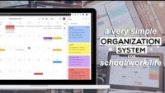
How do Google Calendar and Google Keep Work Together?
Notes:
Let’s watch a brief video of how you can use Google Keep and Google Calendar together! After we finish, consider what are some pros and cons to using this system? Is this something you’d like to try?

Slide 12
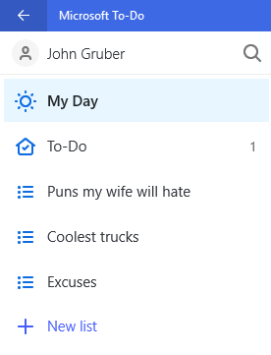
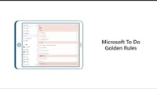
Microsoft to-Do
Works well with Outlook, Teams, Word, etc.
Manage with My Day
Get more done, together!
Notes:
If you want to use an app that works really well with all things Microsoft, To-Do is the app for you! Like Google Keep, Microsoft To-Do works well across all of your devices for easy access and management. You will sign up using your Wake Tech credentials. There are default lists like My Day and Tasks, but you can make this screen as personal as you want! You can create tasks and subtasks to keep track of your day. The app also has a satisfying sound when you complete each task, so it is a great way for you to stay motivated. This brief video shows you some tips and tricks for using Microsoft To-Do
After you finish playing the video, share the following:
Microsoft To-Do works really well with all of the apps you regularly use for Wake Tech, so if you are looking for an application that is easy to start right away, look no further than Microsoft To-Do. Ultimately, whether you choose Google or Microsoft will come down to individual comfort level and which application you believe is more user friendly for you!

Slide 13

Quick Poll: Google or Microsoft?
Which platform sounds like the best fit for you? Answer in the chat!

Slide 14

Why Digital Note taking?
Note taking is one of the most powerful ways you can stay engaged and active in your learning
Note taking helps you recall and apply new knowledge
Times have changed and note taking has too!
What’s a good go between from taking notes on a laptop and paper? Digital Notetaking! Let’s check out a few apps that work really well!
This Photo by Unknown Author is licensed under CC BY-SA-NC
Notes:
The final frontier in digital organization is digital note taking. Note taking is one of the most powerful tools at your disposal as a college student. Studies have shown that note taking helps you recall new knowledge as well as apply it. However, taking notes with a traditional pen and paper isn’t always the best method. On the other hand, studies have shown that when students take notes solely on their laptops, they often retain less information because they attempt to type everything verbatim. Forutnately, there are a few new tools that address the gap in between to help students take notes that they can save digitally and use in the future for success.

Slide 15
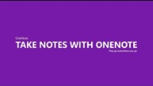
Microsoft one note
Free!
Available with your Wake Tech Login credentials
You can set up your notebooks and divide them into sections and pages
Easy search feature to locate your files quickly and successfully
Type, highlight, or ink annotations
Share and collaborate
Notes:
Microsoft One Note is a great tool that you have free access to using your Wake Tech credentials. It’s a great one stop shop for you to put all of your note taking skills to use in one place. You can revise your notes with typing, highlighting, or ink annotations. You can also add photos and annotate those as well. A great feature about One Note is that you can easily share and collaborate with your professors and classmates. To sum up, One Note is a great system to organize your thoughts. You can mark important notes so you can’t miss them. You can also draw and mix media such as audio or video that you can’t do with other systems. Finally, you can share files, clips, or entire notebooks with your classmates. It also works well across multiple devices, which comes in handy when you’re on the go!
Note to speaker: show students the video for One Note. Remember to reiterate that this works well with outlook, word, etc, and they already have access through their Wake Tech credentials.

Slide 16
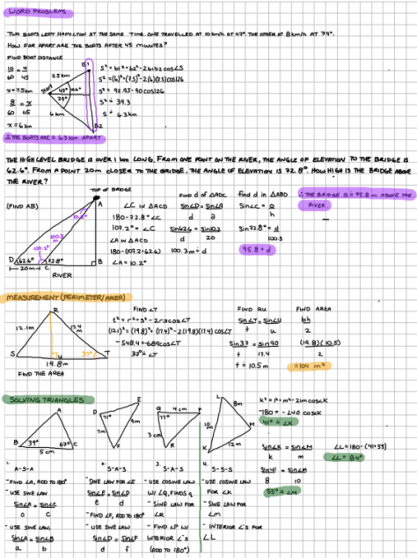
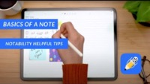
Notability
Take your notes to the next level
This Photo by Unknown Author is licensed under CC BY-SA-NC
Notes:
Notability is a great app that allows you to combine handwriting, photos, and typing in a single note! It also lets you annotate PDFs , and you can use some of the same aforementioned file naming systems to keep all of your notes in one place. The good thing about Notability is that you can use it across devices like your phone, computer, or tablet, and it works with both Apple and Android systems. It is the perfect blend of traditional and modern note taking and it can be as basic or as fancy and you choose. Because of the increased features, there is a cost for Notability, but most users love the platform, and it is very popular. Notability is most popular with students who use a tablet to take notes, so if you do not have a tablet, this system might not be the best for you. Let’s check out this video on Notability, so we can see some of the cool features in action!

Slide 17
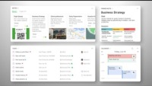
Evernote
Like One Note, Evernote allows you to create notebooks
Works across multiple platforms
Has an easy-to-use search feature so you’ll never lose a note again!
Notes:
Evernote is a great system that incorporates many of the other apps in one clear location! It works across multiple devices, and it connects many of the purposes of the other apps we discussed in one place. You can pretty much put any type of content into Evernote. Type, write, or record audio from a class. Annotate photos and PDFS
Snap photos of a whiteboard or post it note from class. You can also use it on whatever device you are logging in from right now! It’s a simple one stop platform that helps you get everything in one place. Evernote is free. If you don’t want to use a bunch of apps to stay organized digitally, Evernote might be the best solution for you. Let’s watch a video to see how this works in action!

Slide 18
Which System is Right for you?
Now that you have been introduced to a few systems for staying organized digitally, which app or apps will you explore?
Answer in the chat!
Notes:
Have students answer in the chat by providing specific examples to justify their choices!

Slide 19

Final Tips!
Clear your desktop
Delete your downloads file
Organize your documents into folders
Inbox Zero
Check for and Install Updates
This Photo by Unknown Author is licensed under CC BY
Notes:
Without intending for it to do so, your desktop can pile up quickly. Put any loose documents into a specific folder. Change your desktop background to something that you want to see so that you will notice when it gets cluttered
Go through this folder regularly to store what you need and delete the rest
Folders on folders! Make sure everything is in its place for easy access
Check your email at least once a day and get to zero if possible. Unsubscribe from unwanted notifications
Don’t let updates go unchecked! Stop clicking remind me tomorrow

Slide 20

Final Tips
6. Delete duplicates
7. Organize your apps
8. Delete old notes
9. Turn off Notifications
Notes:
6. Sometimes we accidentally save a file twice. Delete any extra copies to avoid confusion
7. Organize your apps on your tablet or phone to help you find items easily on your computer
8. Your notes app gets cluttered. Take a moment and go through the ones you don’t need and delete them
9. Finally, you need to maintain some work/life balance. Consider turning off notifications so you are not working late into the night. Everyone needs a break.

Slide 21

3-2-1 Exit ticket
What are three things you learned in today’s session
What are two things you found interesting?
What is one question you still have?
If time allows, try a new app and see what you like! I’ll hang around if you have a question.
Thanks for attending today’s session!
Notes:
Have students respond to the final question and thank them for their attendance. If anyone has any specific questions, let them know that I will follow up with them. If time allows, let students hang out and ask questions or try out a new app of their choosing. Thank students for attending today’s session!

